Slide 1
Bank Marketing Dataset Team Project
Sherif Ahmed
Team members : Nagham Mohamed
Mahmoud Marey

Slide 2
Table of contents
Problem Statement
Business Question
Information About The Data
EDA And Visualization
Data Pre-processing
Modelling
Deployment

Slide 3
Problem Statement
Banks spends a lot of time, money and efforts in making marketing campaigns. The goal of this campaigns is to bring new and returning customers. The dataset that we are working with is related with direct marketing campaigns of a Portuguese banking institution.
The marketing campaigns were based on phone calls. Often, more than one contact to the same client was required, in order to access if the product (bank term deposit) would be ('yes') or not ('no') subscribed.

Slide 4
Business Question
The banks consume a lot of money and time in these marketing campaigns so if there’s a model can predict accurately whether the customer will subscribe or not, then banks will save a lot of effort, money and time as then they can know better what can raise the probability of customer subscription and the campaigns will be more targeted for persons that are more likely to subscribe which can save more and more money and time.

Slide 5
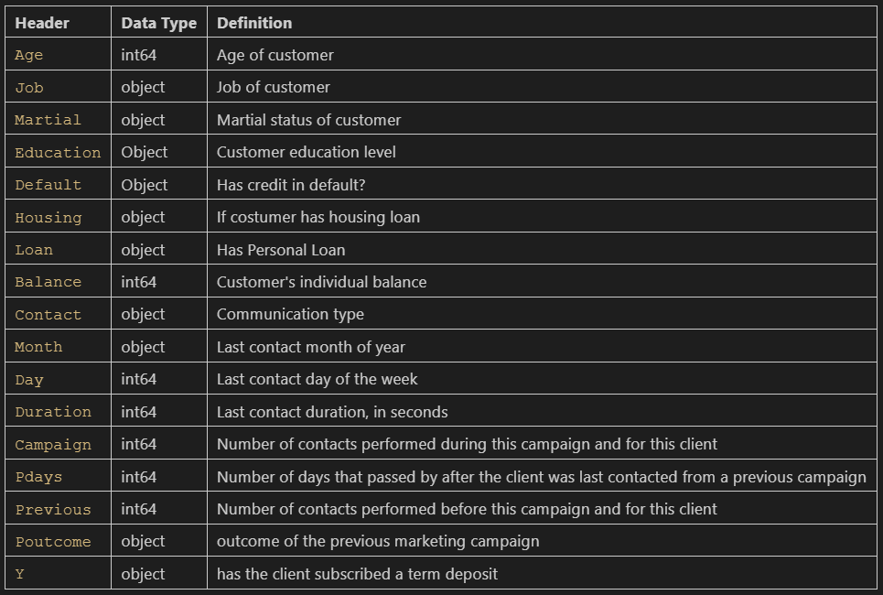
Information About The Data

Slide 6
EDA And Visualization
Categorical Values
Numerical Values

Slide 7
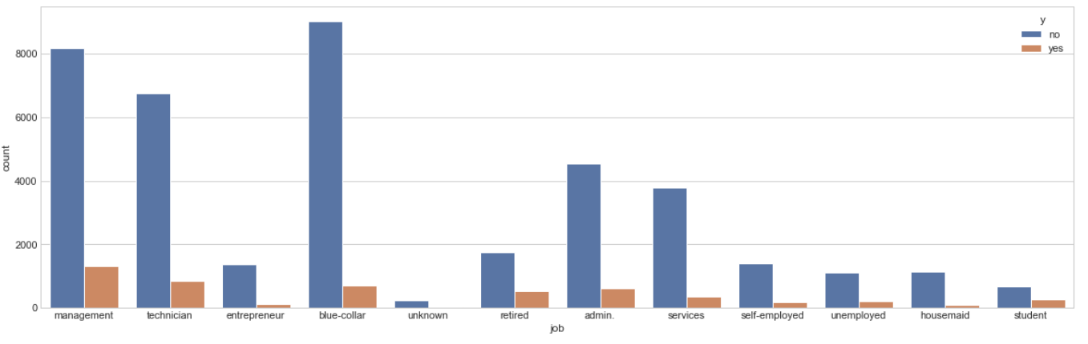
CATEGORICAL VALUES
The feature is job and number of categories are 12
Count-plot for the yes’s & no’s of each category :

Slide 8
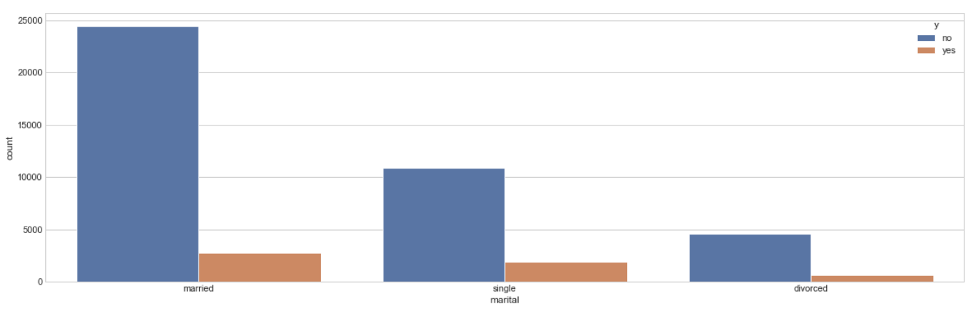
The feature is marital and number of categories are 3
Count-plot for the yes’s & no’s of each category :

Slide 9
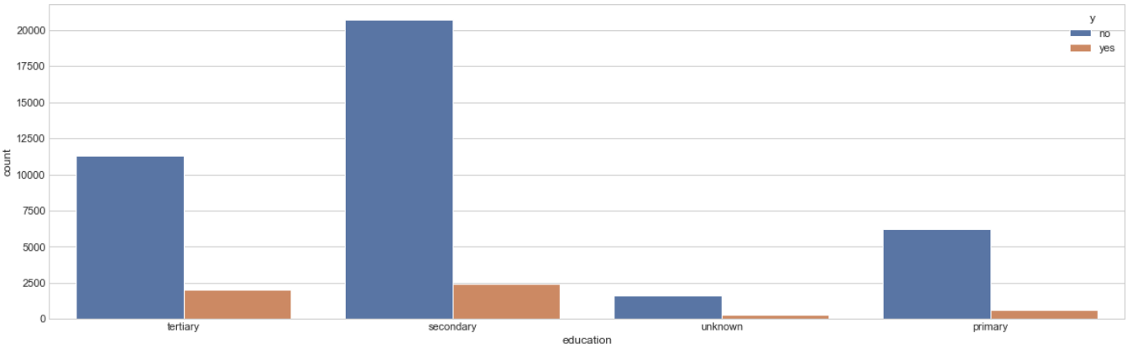
The feature is education and number of categories are 4
Count-plot for the yes’s & no’s of each category :

Slide 10
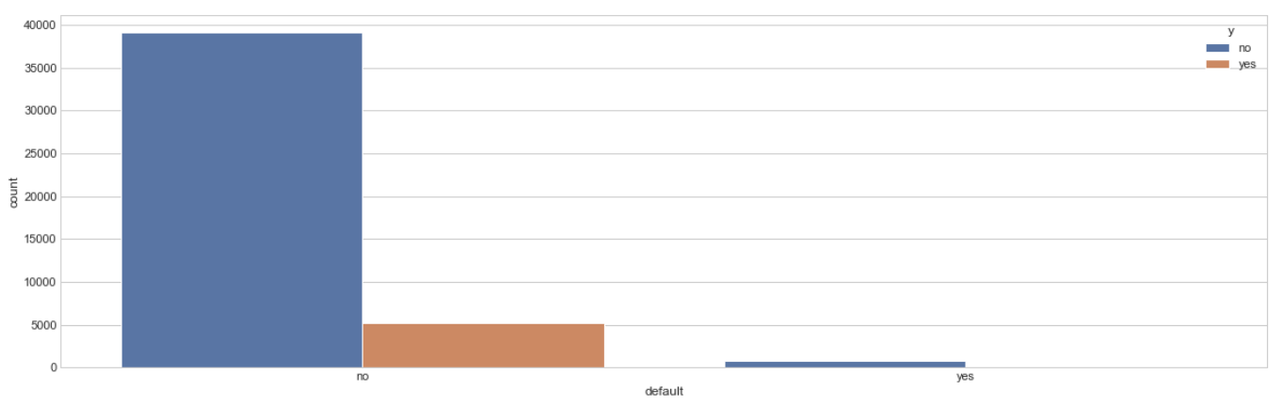
The feature is default and number of categories are 2
Count-plot for the yes’s & no’s of each category :

Slide 11
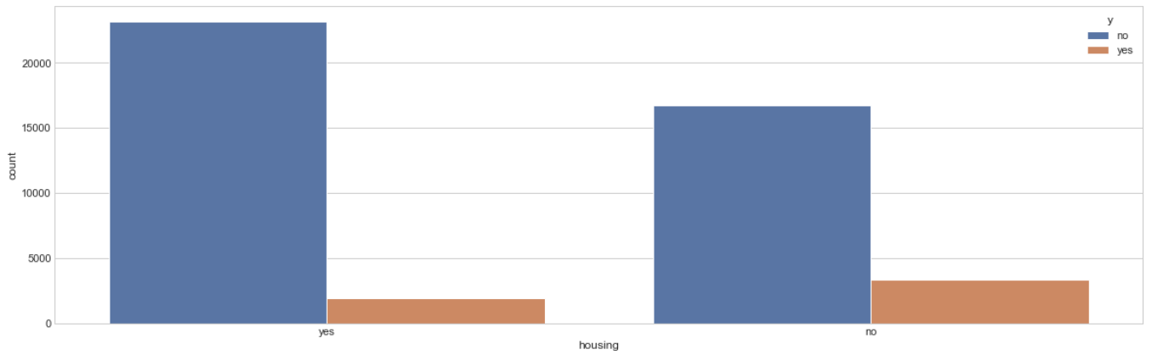
The feature is housing and number of categories are 2
Count-plot for the yes’s & no’s of each category :

Slide 12
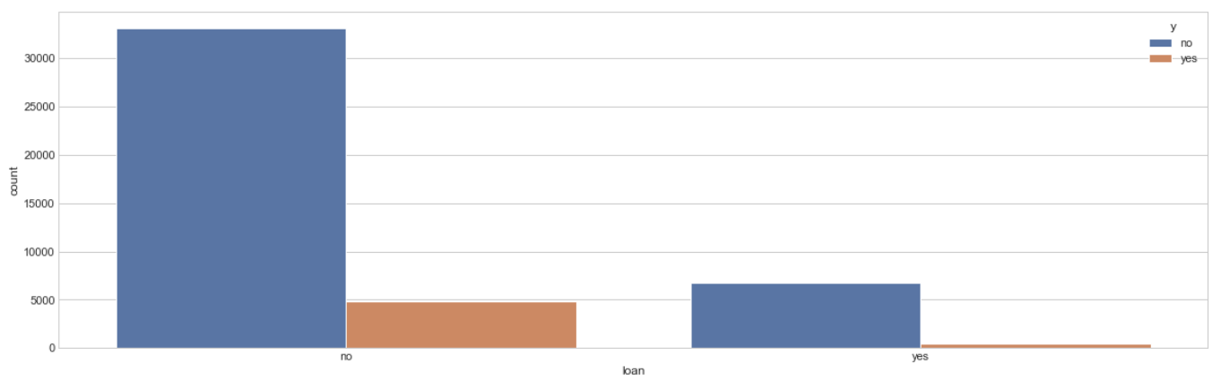
The feature is loan and number of categories are 2
Count-plot for the yes’s & no’s of each category :

Slide 13
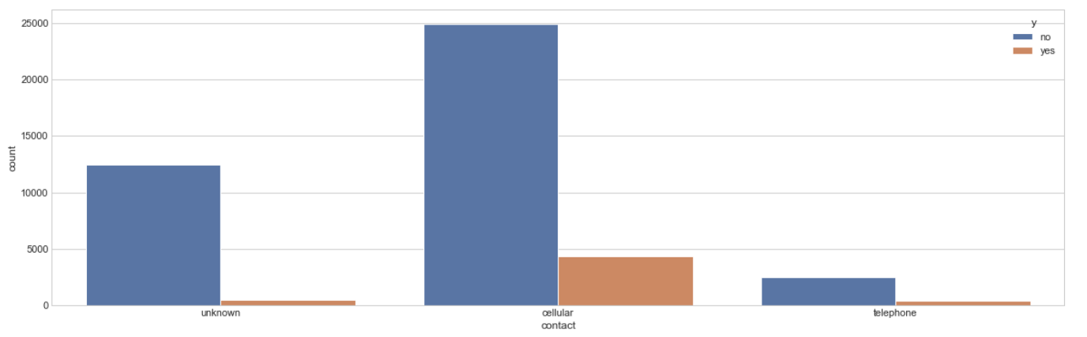
The feature is contact and number of categories are 3
Count-plot for the yes’s & no’s of each category :

Slide 14
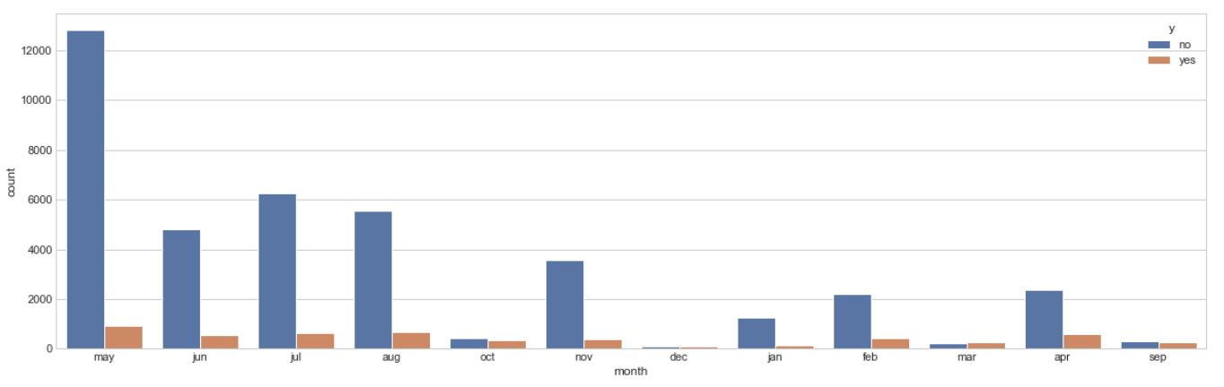
The feature is month and number of categories are 12
Count-plot for the yes’s & no’s of each category :

Slide 15
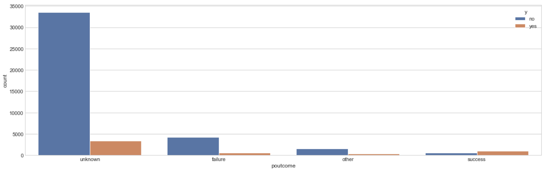
The feature is poutcome and number of categories are 4
Count-plot for the yes’s & no’s of each category :

Slide 16
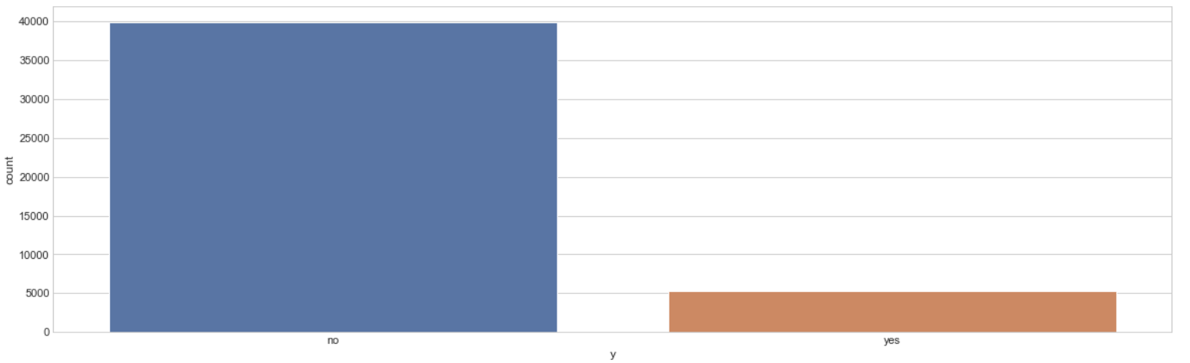
The feature is y and number of categories are 2
Count-plot of each category :

Slide 17
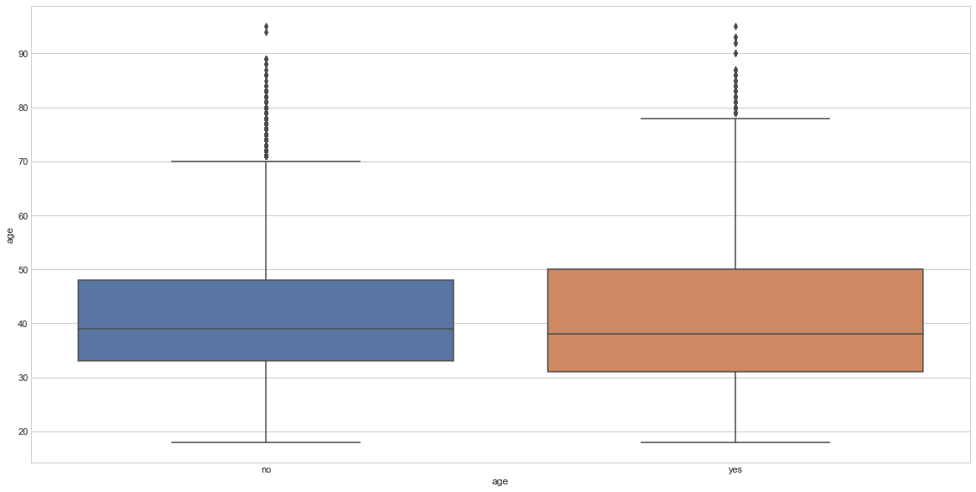
NUMERICAL VALUES
The feature is age and number of unique values are 77
Box-plot for the yes’s & no’s :

Slide 18
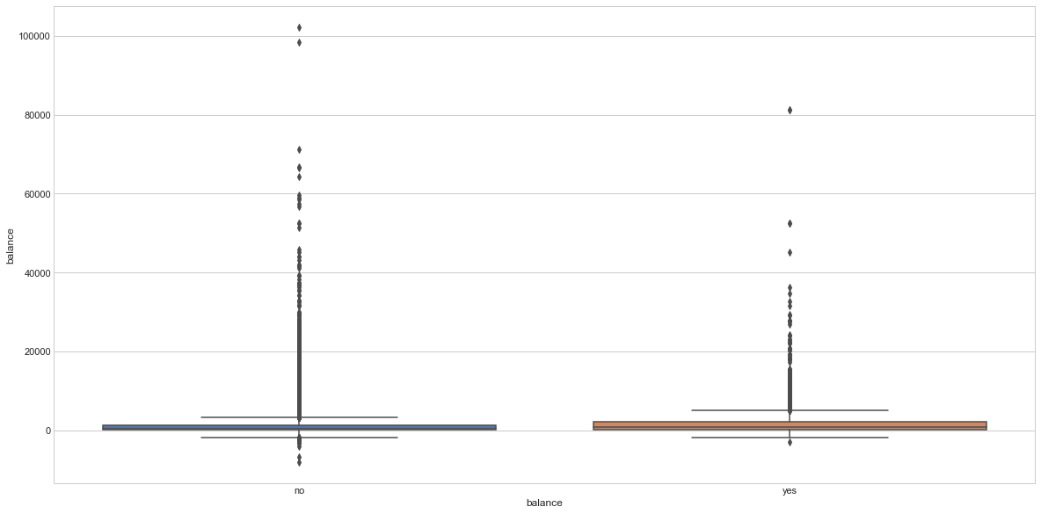
The feature is balance and number of unique values are 7168
Box-plot for the yes’s & no’s :

Slide 19
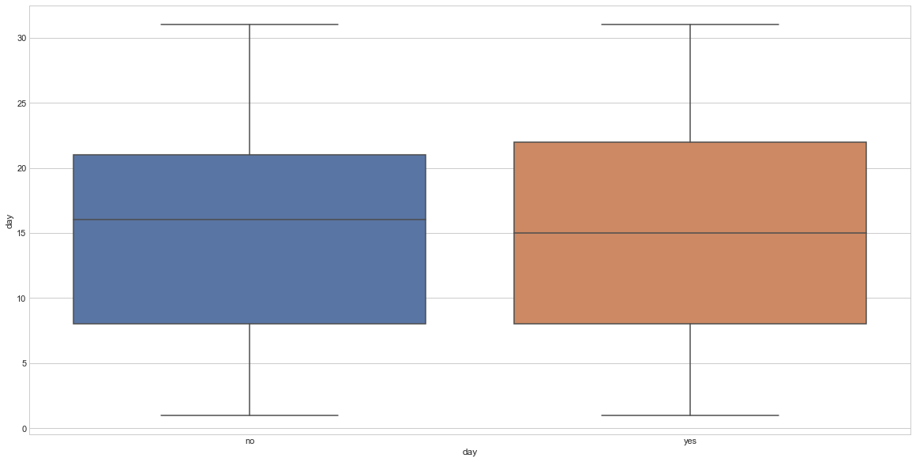
The feature is day and number of unique values are 31
Box-plot for the yes’s & no’s :

Slide 20
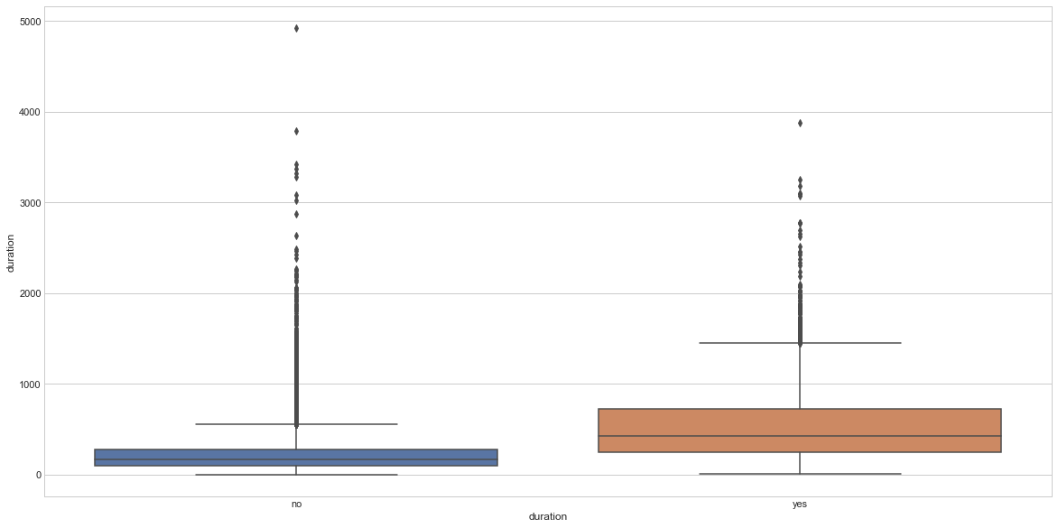
The feature is duration and number of unique values are 1573
Box-plot for the yes’s & no’s :

Slide 21
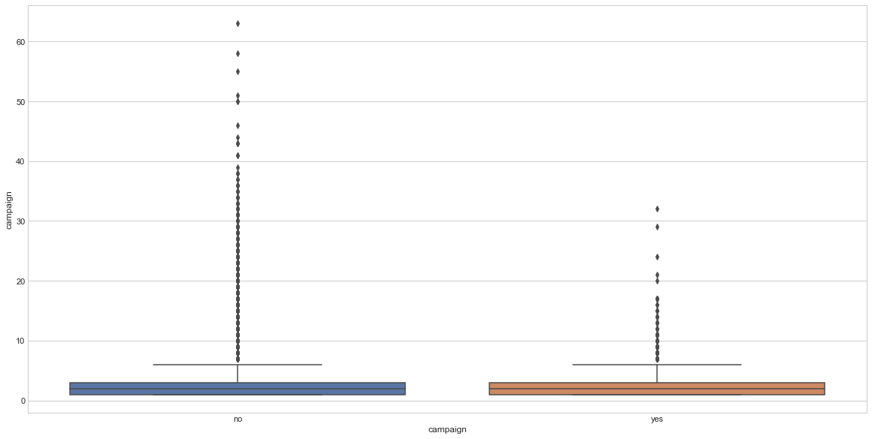
The feature is campaign and number of unique values are 48
Box-plot for the yes’s & no’s :

Slide 22
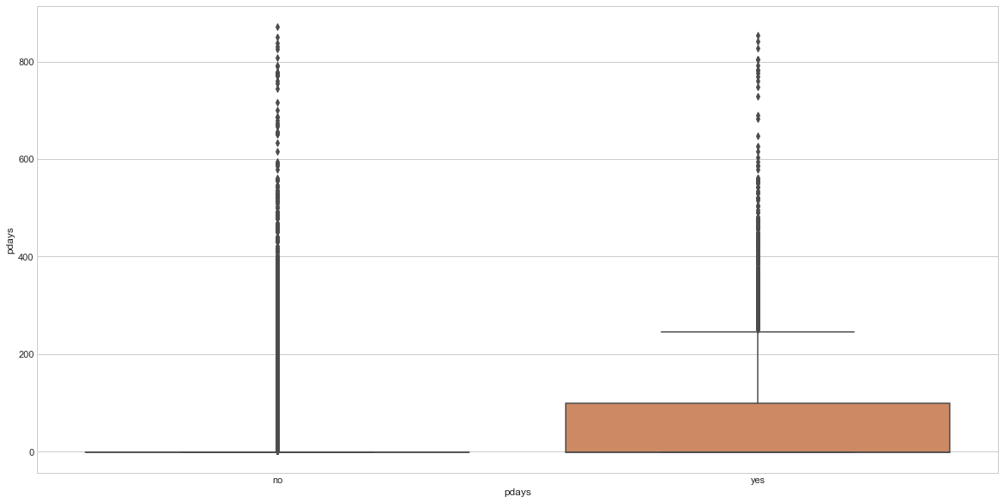
The feature is pdays and number of unique values are 559
Box-plot for the yes’s & no’s :

Slide 23
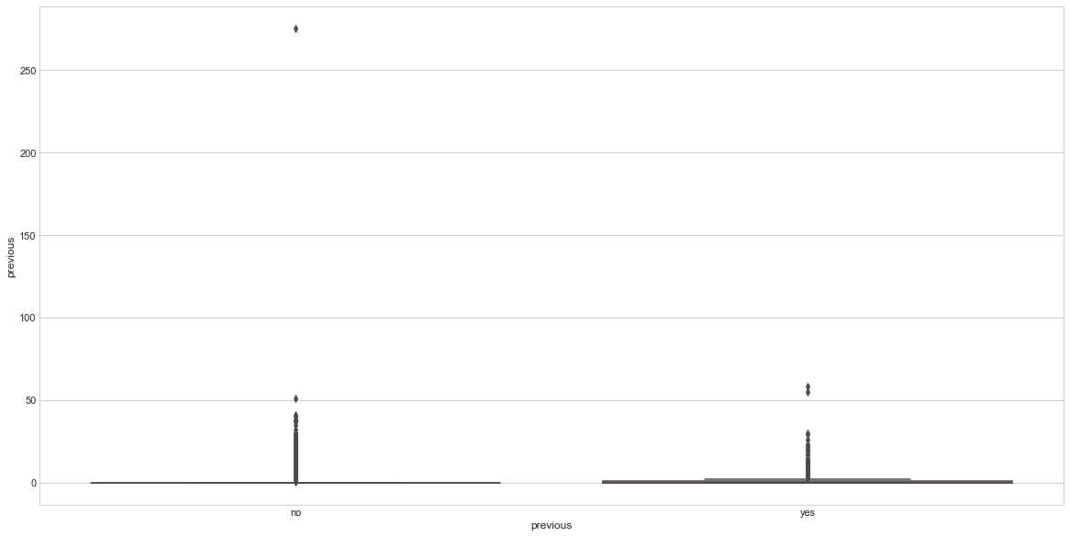
The feature is previous and number of unique values are 41
Box-plot for the yes’s & no’s :

Slide 24
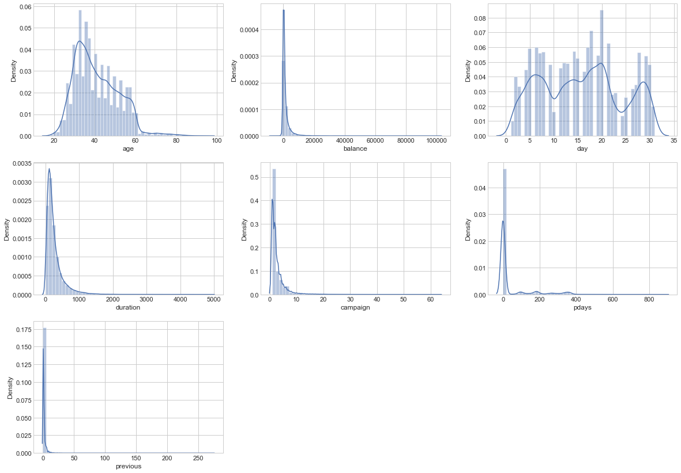
Histograms And KDE Curves Of All The Numerical Features To Show Their PDFs:

Slide 25
Data Pre-processing
Remove null values and duplicates
Correlation Analysis ( Heat Map )
Encoding
Normalization
Feature Selection
Splitting The Data
Oversampling

Slide 26
Remove null values and duplicates
We do not have any missing values.
There are no duplicates in the dataset.

Slide 27
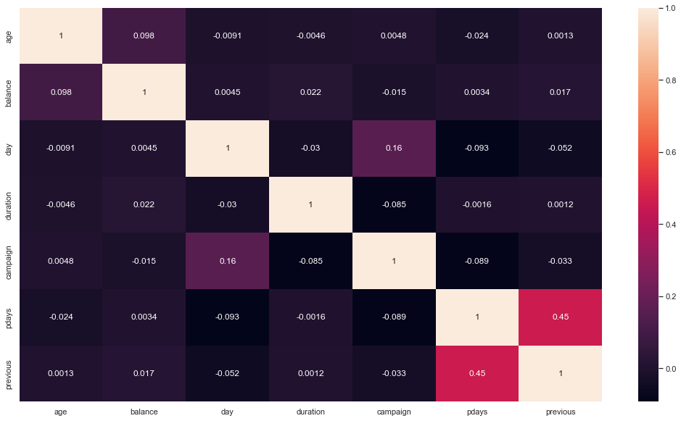
Correlation Analysis ( Heat Map )

Slide 28
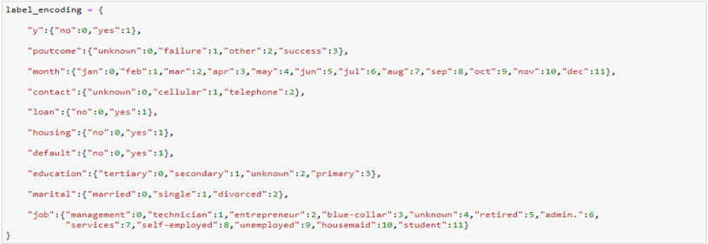
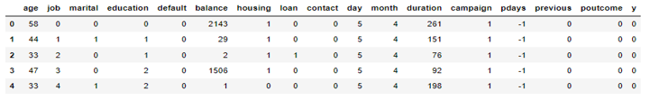
Encoding

Slide 29
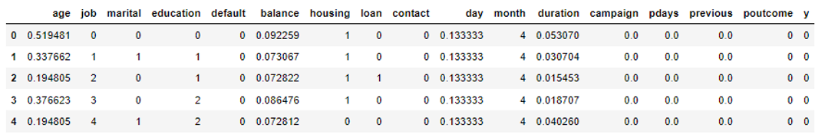
Normalization

Slide 30
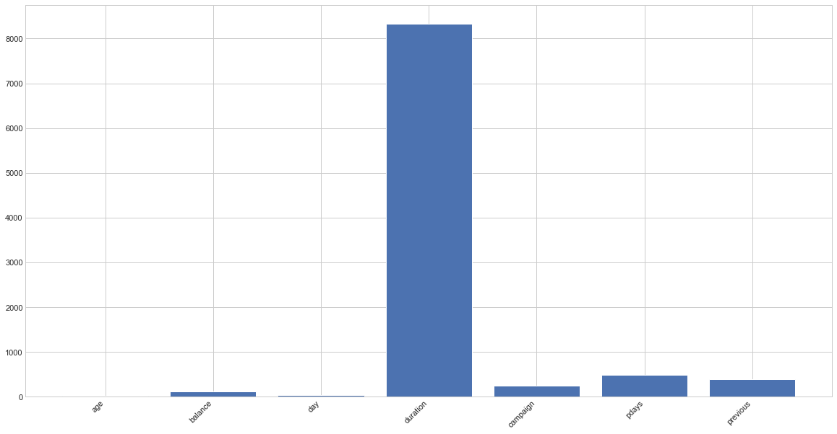
Feature Selection
Feature selection for numerical features

Slide 31
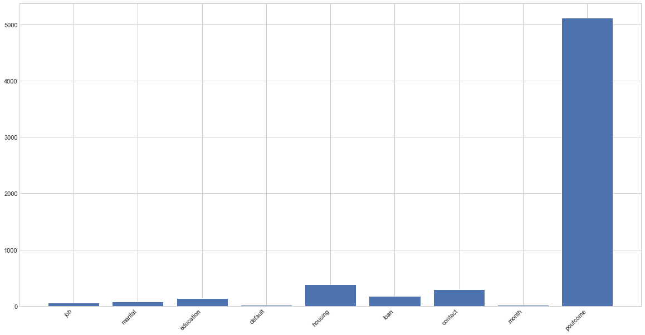
Feature selection for categorical features

Slide 32
Splitting The Data
Train data size: 80%
Test data size: 20%
Note:
Stratification was used in train_test_split method which returns training and test subsets that have the same proportions of class labels as the input dataset.

Slide 33

Oversampling

Slide 34
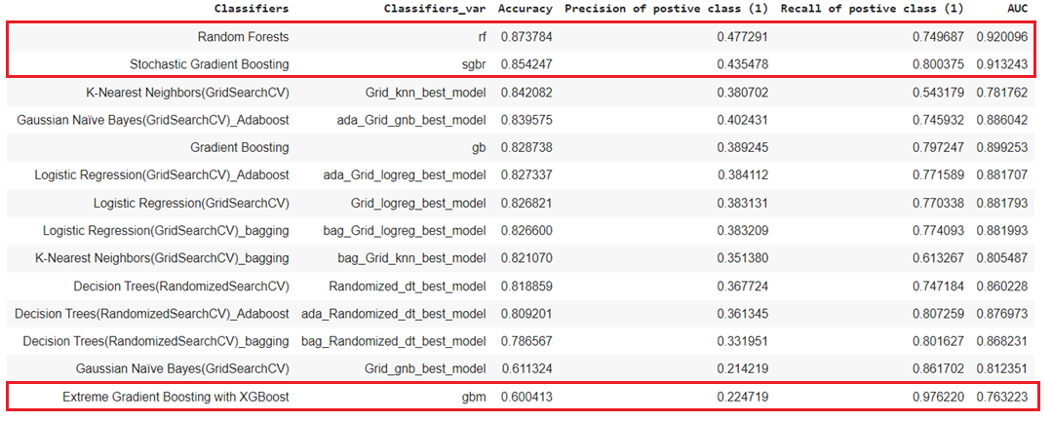
Modelling

Slide 35
The Voting Classifier achieved the best combined accuracy, precision and recall over any other classifier.
In our opinion the recall of the positive class (yes to the term deposit) is the most important metric to look at business value wise.

Slide 36
Deployment
We used Streamlit which is an open source app framework in Python language.
It helps us create web apps for data science and machine learning in a short time.
It is compatible with major Python libraries such as scikit-learn, Keras, PyTorch, SymPy(latex), NumPy, pandas, Matplotlib etc.

Slide 37
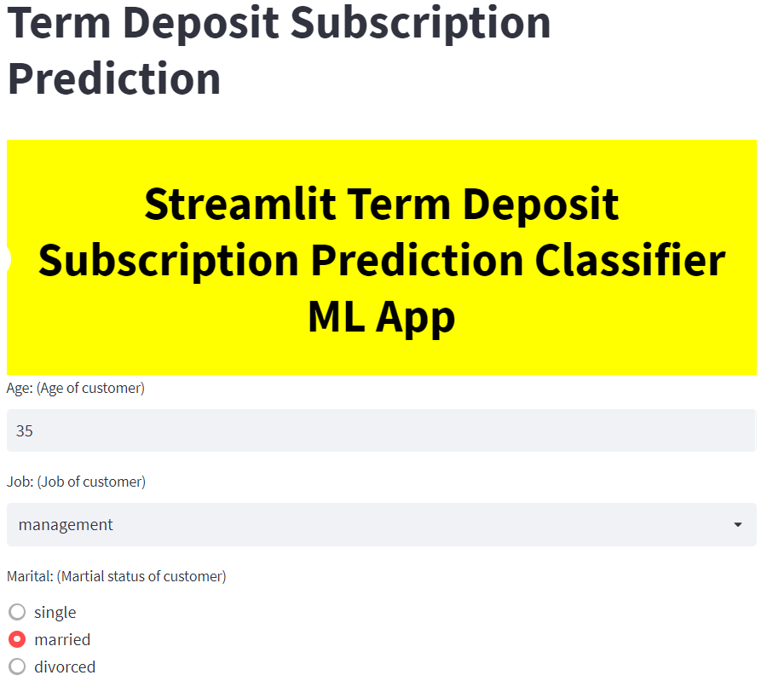
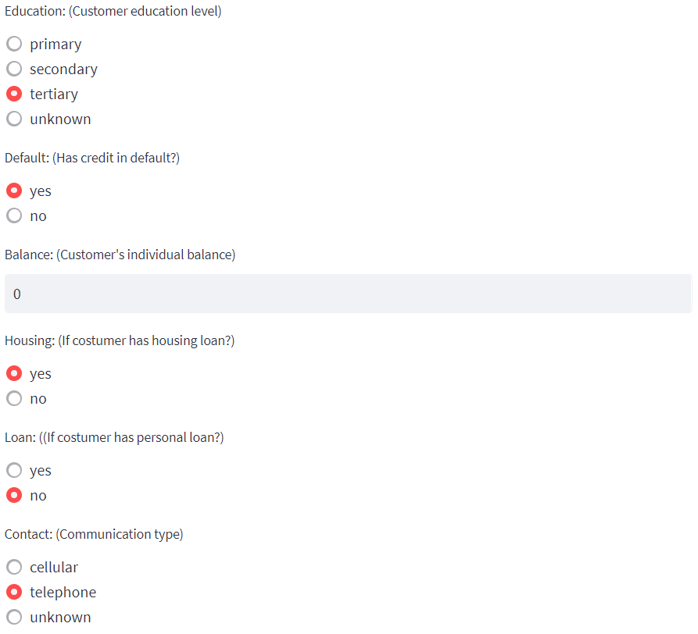
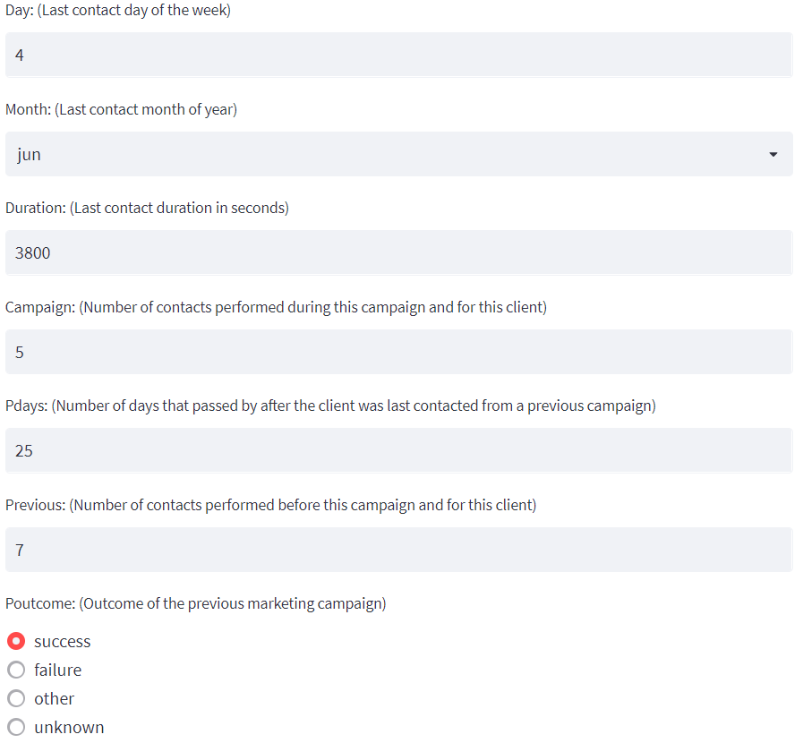
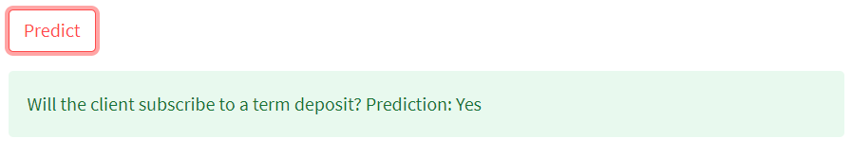

Slide 38
Thank You

